Slide 1

A key Characteristic of High Performing Teams:
accountability
?
“Isn’t that Responsibility?”
They are related but distinctly different

Slide 2
Responsibility:
The obligation to perform a task.
Accountability:
Answering for the outcome of a task.
The action
The result

Slide 3
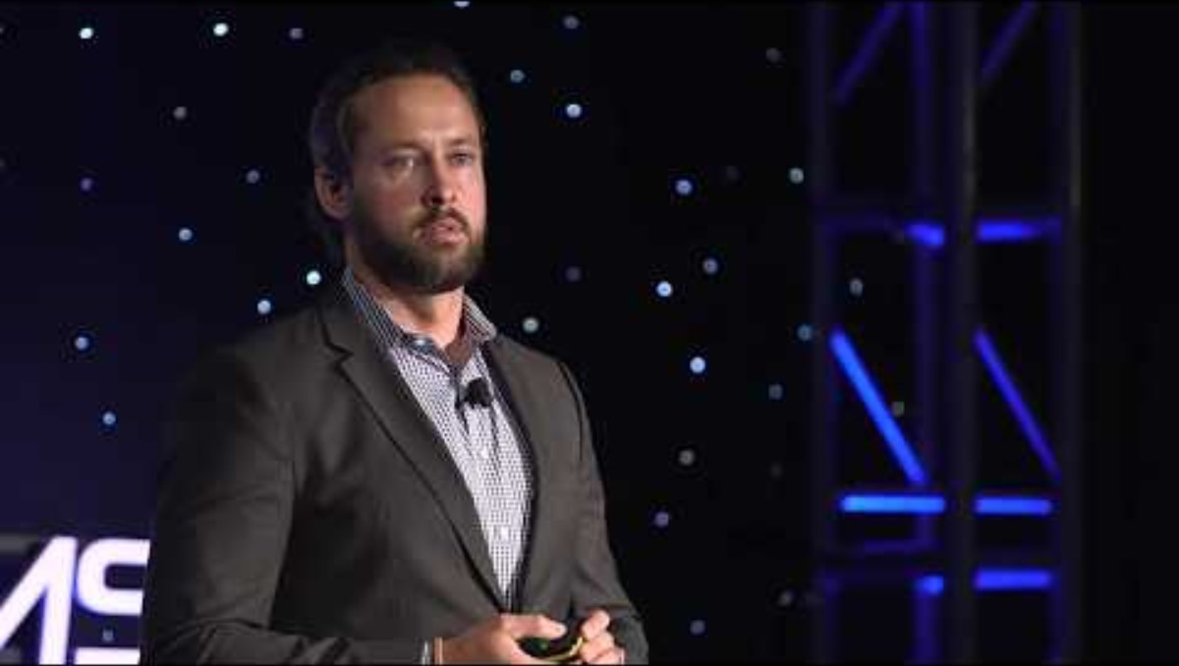
Navy Seal Combat Veteran Brent Gleeson

Slide 4

To Improve Efficiency, Speed, and Morale…
Hold Ourselves
Accountable
If I drop the ball or make a mistake,
it’s not enough to just accept responsibility for it,
I must change my behavior

Slide 5
Blame: A Strategy to Get Others to Take Ownership of Problems
Managers seeking details punish those bringing bad news
Employees protect themselves
can’t admit mistakes and therefore, can’t learn from them
Individuals spend time denying problems…
rather than solving them.

Slide 6
A person who has been punished
is not simply less inclined
to behave in a given way;
at best, he learns to
avoid punishment
B.F. Skinner

Slide 7

Process, policy, and system failures
Have Greater influence over outcomes than…
Individuals
Processes not clearly identified
Policies not enforced
People, Process, and Technology failures

Slide 8



Create a Learning Environment
Debrief Meetings
allow teams to identify areas for improvement
Leave emotion at the door FACTS
Be transparent and honest.
Give everyone a voice regardless of rank, title or tenure.
This sets the tone for openness and accountability.

Slide 9

Feedback Loops
Fuel continual improvement by applying lessons learned
What was the objective?
Where did we hit or miss?
What was the root cause?
What should we stop, start or continue doing?
The 5 WHYs

Slide 10
How to Foster Accountability in the Workplace
Be willing to be held accountable
  “Did I have a role in this situation?”
Identify Success
Goals and metrics
Create a culture of trust
Be fair, reliable, and consistent.
Be transparent about failures to LEARN
  Ask for assistance - Knowledge is power.

Slide 11

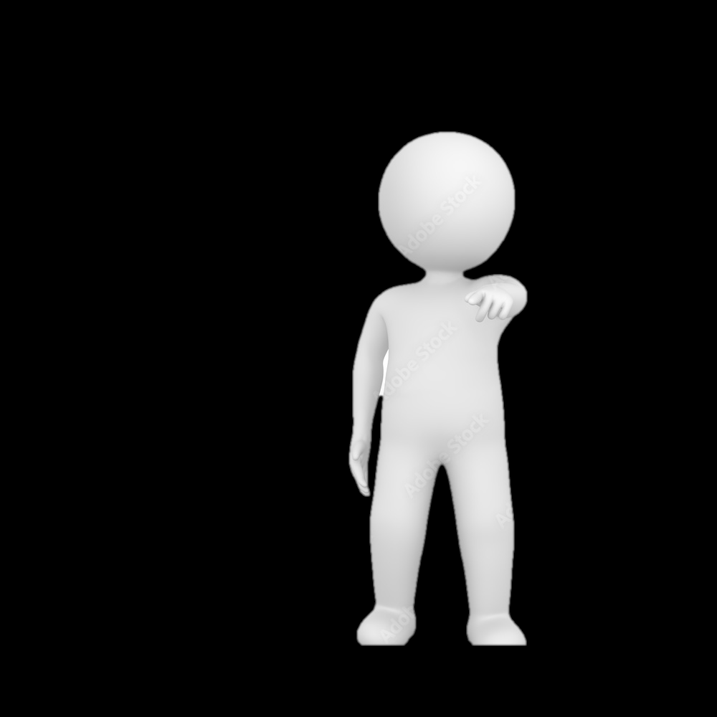

Be proactive:
Solve problems & seeking solutions
Be brave:
Have difficult conversations.
Be vulnerable:
Ask for support.
Admit errors instead of covering up mistakes.
HELP

Slide 12
ACCOUNTABILITY
“What happened here?”
“Is there anything in the process that increased the risk of error?”
“Let’s see what we need to do to get the results we want.”
“Let’s talk about this mistake so we can learn and do better next time.”
BLAME
“Who made the mistake?”
“What you did is wrong”

Slide 13
ACCOUNTABILITY:
Ensures the success of strategic objectives.
Strategies include:
setting clear goals,
establishing frameworks,
providing feedback.

Slide 14
“Wisdom stems from personal accountability. We all make mistakes; own them…learn from them. Don’t throw away the lesson by blaming others.”
Steve Maraboli

